Slide 1

MOVIE RECOMMENDATION BASED ON EMOTIONS
Presented By : Sahil Vijay pisal
Date : 16/02/2025
Project Guide : prof.projyot Patil
Team Members :
Om Nandkumar Ghorpade
Sahil Vijay Pisal
Vaishnav Ingale

Slide 2
Project Overview
Project Description
The goal of this project is to develop a movie recommendation system that suggests films based on a user's current emotional state. The system aims to provide personalized recommendations by analyzing the emotional content of movies and matching them with the user's emotions.
Goal
1. Develop a system that can analyze the emotional content of movies.
2. Create a user interface to collect user emotions and preferences.
3. Design an algorithm to match user emotions with movie recommendations.
4. Evaluate the performance of the recommendation system.
Context
With the rise of online streaming services, users are overwhelmed with choices when it comes to selecting a movie to watch. Traditional movie recommendation systems rely on collaborative filtering, content-based filtering, or hybrid approaches. However, these methods often neglect the emotional aspect of movie watching, which plays a crucial role in user satisfaction.

Slide 3
Problem Statement
Description:
Traditional movie recommendation systems rely on collaborative filtering, content-based filtering, or hybrid approaches. However, these methods often neglect the emotional aspect of movie watching, which plays a crucial role in user satisfaction. This project addresses this gap by developing an emotion-based movie recommendation system
Issues:
Users often struggle to find movies that match their current emotional state. For example, a user who is feeling stressed may want to watch a calming movie, while a user who is feeling adventurous may want to watch an action-packed movie. Current movie recommendation systems do not take into account the user's emotional state, leading to dissatisfaction and frustration.
Key Challenges:
Emotional Analysis Challenges1. Emotion Recognition: Developing an accurate emotion recognition system that can detect and classify emotions from user input (e.g., text, speech, facial expressions).2. Emotion Complexity: Handling complex emotions and nuanced emotional states, such as mixed emotions or emotional intensity.3. Contextual Understanding: Understanding the context in which the user is watching the movie, including environmental factors and personal preferences.

Slide 4
Data Related Information
Data Structure
Movie-Emotion Matrix: a matrix representing the emotional tags associated with each movie
2. User-Emotion Matrix: a matrix representing the emotional preferences of each user
3. User-Movie Matrix: a matrix representing the watch history and ratings of each user for each movie
Data Representation
JSON (JavaScript Object Notation) for representing complex data structures, such as emotional profiles and movie metadata.
- CSV (Comma Separated Values) for storing and exchanging data between different systems.
- Data frames or matrices for representing numerical data, such as user ratings and emotional intensities.
Data types
Integer
Float
Boolean
Enum
Datetime
Data pattern and trends
User Data patterns
Movie data patterns
Recommendation Data patterns

Slide 5
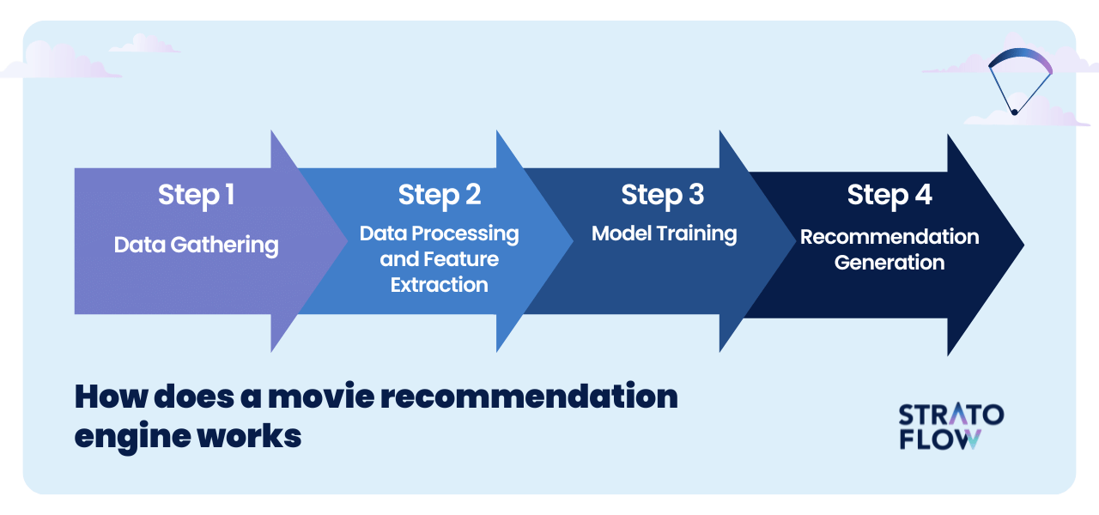
Project Flow

Slide 6
Methodology
Data Collection:
Gather a dataset of movies with their corresponding emotional content (e.g., genres, emotional keywords, sentiment analysis).
2. Emotion Analysis:
Develop a natural language processing (NLP) module to analyze user input (e.g., text, speech) and determine their current emotional state.
3. Recommendation Algorithm:
Design a machine learning-based algorithm to match user emotions with movie recommendations.
4. System Evaluation:
Assess the performance of the recommendation system using metrics such as precision, recall, and user satisfaction.

Slide 7
Team Members
TEAM MEMBER NAME | INDIVIDUAL ROLE | KEY CONTRIBUTION
1.Om Nandkumar Ghorpade | Python Machine Learning | Team work coordination, Timely execution of each task
2.Vaishnav Ingale | Python deep Learning | Explaining project details, Contributing in projects progress
3.Sahil Vijay Pisal | Data analysis | Collecting data requirements and ensuring timely executions of work

Slide 8
Advantages and Disadvantages
ADVANTAGES
Personalized Recommendations: Users receive movie recommendations tailored to their emotional preferences, increasing user satisfaction.
Emotional Resonance: Movies that evoke strong emotions in users are more engaging and memorable.
Improved User Experience: The system provides a unique and engaging way for users to discover new movies.
Scalability: The system is designed to handle large volumes of user data and movie metadata.
Emotional Intelligence: The system promotes emotional intelligence by encouraging users to recognize and understand their emotions.

Slide 9
Advantages and disadvantages
DISADVANTAGES
Complexity: The system requires advanced natural language processing (NLP) and machine learning techniques, making it complex to develop and maintain.
Data Quality Issues: The system relies on high-quality emotional data from users, which can be noisy, biased, or incomplete.
Emotion Recognition Limitations: The system's emotion recognition capabilities may not always be accurate, leading to incorrect recommendations.

Slide 10
Why this problem is important
1.Advancements in NLP and Machine Learning:
Developing an Emotion-Based Movie Recommendation System requires advancements in natural language processing (NLP) and machine learning techniques
2. Emotion Recognition and Analysis:
The system can contribute to the development of emotion recognition and analysis techniques, with applications in various fields, such as psychology, marketing, and healthcare.
3. Personalization and Recommendation Systems:
The system can serve as a model for developing personalized recommendation systems in other domains, such as music, products, or services.

Slide 11
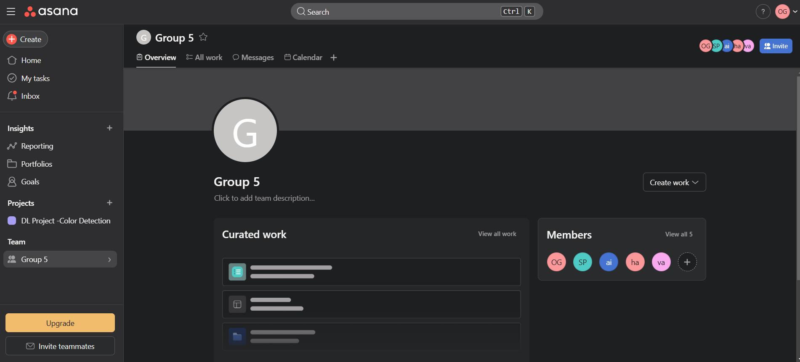
Screenshot Or Visuals

Slide 12
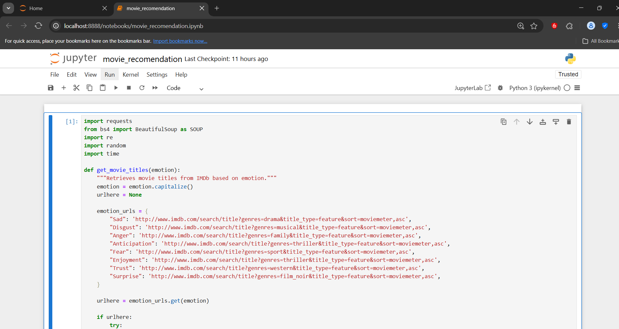
Project Code

Slide 13
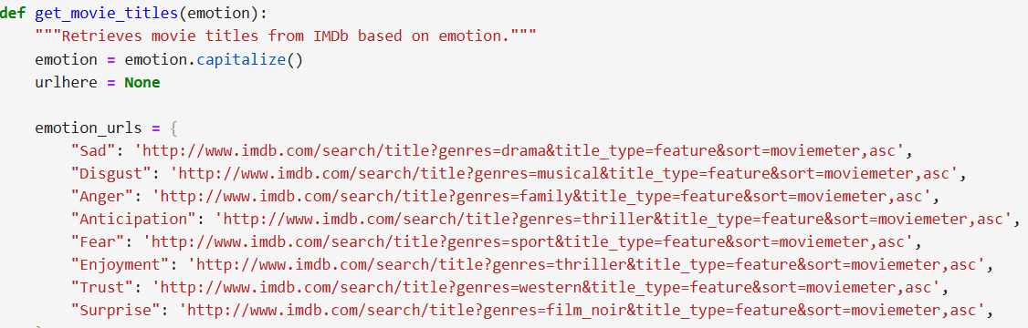
Movies Links

Slide 14
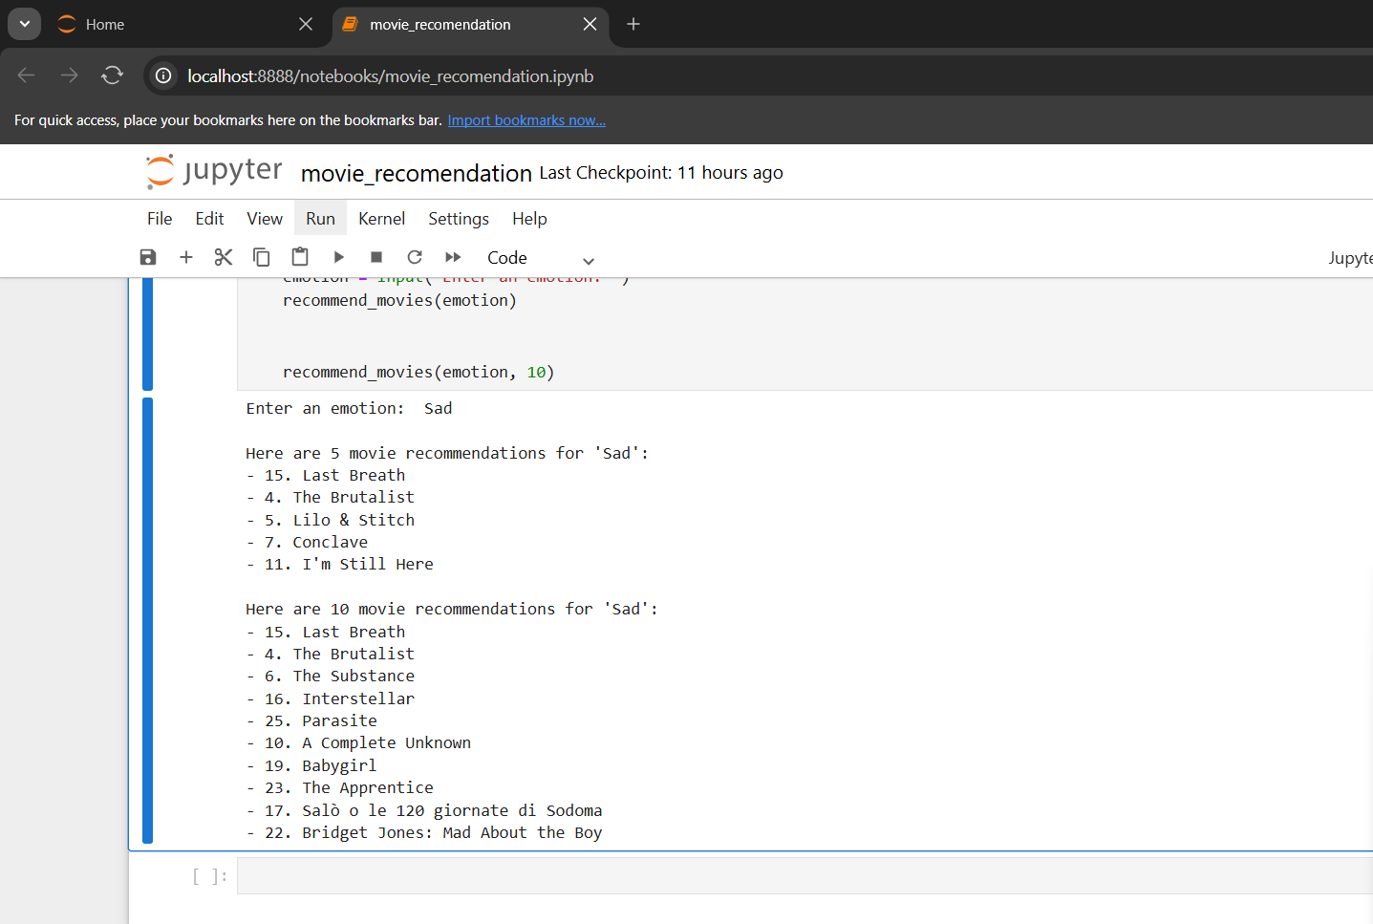
Output

Slide 15
Synopsis
Synopsis: Movie Recommendation Based On Emotions
The Emotion-Based Movie Recommendation System is a personalized recommendation system that suggests movies based on a user's emotional state. The system uses natural language processing (NLP) and machine learning techniques to analyze user emotions and movie metadata.
Improved user experience, increased user engagement, and a competitive advantage for streaming services and entertainment companies.

Slide 16
Expected Conclusion
The Emotion-Based Movie Recommendation System offers a groundbreaking approach to personalized movie recommendations, leveraging natural language processing and machine learning techniques to analyze user emotions and movie metadata. By providing users with emotionally resonant movie suggestions, this system has the potential to revolutionize the way we interact with movies and streaming services.

Slide 17
Research Paper
1."Movie Recommendation System Based on Collaborative Filtering" by J. Lee et al. (2019)
2. "Content-Based Movie Recommendation System Using Deep Learning" by Y. Zhang et al. (2020)
3."Emotion-Based Recommendation System for Movies" by S. K. Goyal et al. (2018)
4. "Affective Recommendation Systems: A Survey" by F. Zhang et al. (2019)

